Slide 1

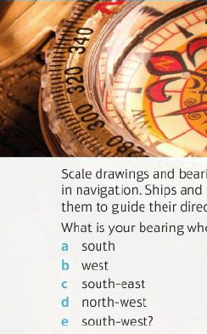
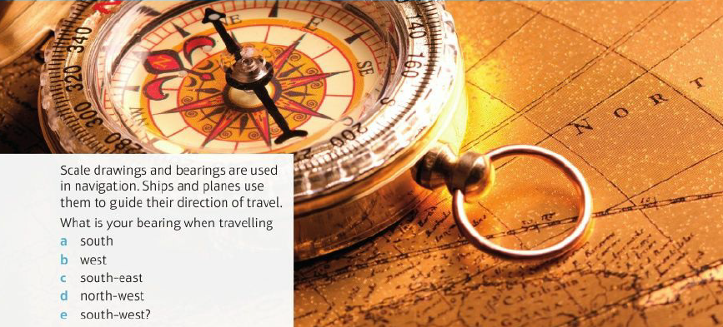
Mathematics (9-1) - iGCSE
2018-20
Year 09
Scale drawings and bearings are used in navigation. Ships and planes use them to guide their direction of travel. What is your bearing when travelling
South
West
South-east
North-west
South-west
Unit 8 – Transformations And Constructions

Slide 2
Contents
Page iv
8 Transformations and constructions 239
Prior knowledge check 239
8.1 3D solids 240
8.2 Reflection and rotation 242
8.3 Enlargement 245
8.4 Transformations and combinations of transformations 249
8.5 Bearings and scale drawings 253
8.6 Constructions 1 256
8.7 Constructions 2 259
8.8 Loci 262
Problem-solving: Under construction 265
Check up 266
Strengthen 268
Extend 273
Knowledge check 275
Unit test 277

Slide 3
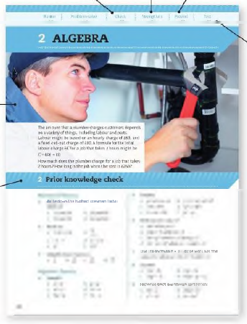
Contents
Page v
At the end of the Master lessons, take a check-up test to help you to decide whether to strengthen or Extend our learning
Extend helps you to apply the maths you know to some different situations
Unit Openers put the maths you are about to learn into a real-life context. Have a go at the question - it uses maths you have already learnt so you should be able to answer it at the start of the unit.
When you have finished the whole unit, a Unit test helps you see how much progress you are making.
Choose only the topics in strengthen thay you need a bit more practice with. You’ll find more hints here to lead you through specific questions. Then move on to Extend
Use the Prior knowledge check to make sure you are ready to start the main lessons in the unit. It checks your knowledge from Key Stage 3 and from earlier in the GCSE course. Your teacher has access to worksheets if you need to recap anything.

Slide 4
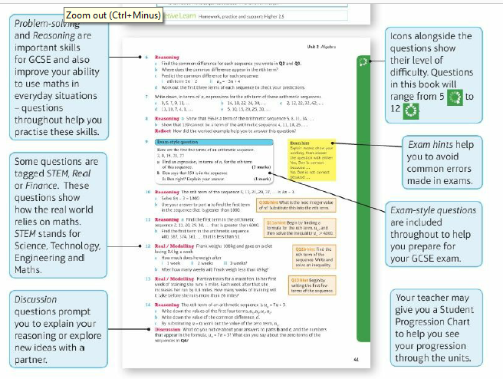
Contents
Page vi

Slide 5
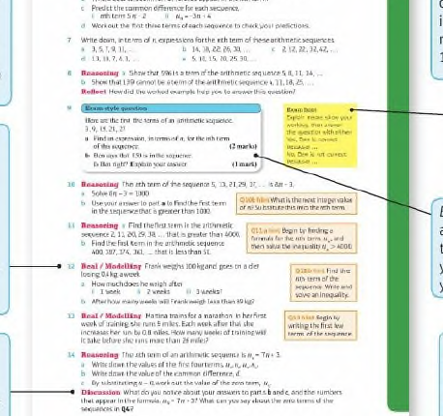
Contents
Page vi

Slide 6
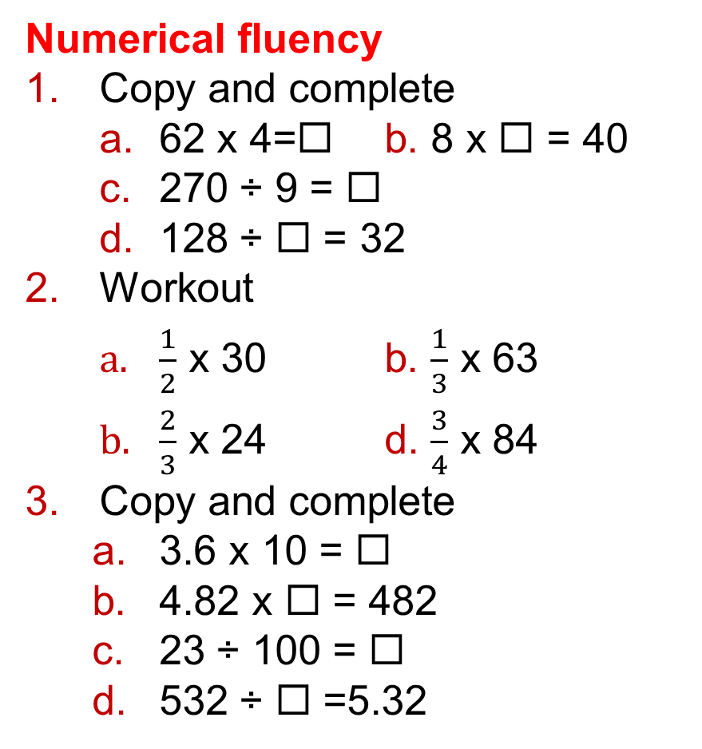
8 – Prior Knowledge Check
Page 239
Numerical fluency
Copy and complete
  62 x 4=◻ b. 8 x ◻ = 40
  270 ÷ 9 = ◻
  128 ÷ ◻ = 32
Workout
  $\frac{1}{2}$ x 30 b. $\frac{1}{3}$ x 63
  $\frac{2}{3}$ x 24 d. $\frac{3}{4}$ x 84
Copy and complete
  3.6 x 10 = ◻
  4.82 x ◻ = 482
  23 ÷ 100 = ◻
  532 ÷ ◻ =5.32

Slide 7
8 – Prior Knowledge Check
Page 239
Fluency with measures
Copy and complete
    1m = ◻ cm
    1km = ◻ m
    1km = ◻ cm
How many
  cm in 4m
  m in 6.2km?

Slide 8
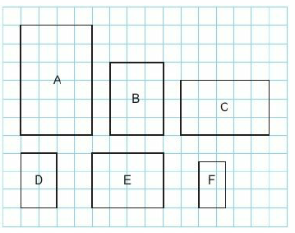
8 – Prior Knowledge Check
Page 239
Geometric Fluency
a. Which of these shapes are congruent?
  Which of these shapes are similar?

Slide 9
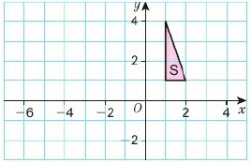
8 – Prior Knowledge Check
Page 240
a. Copy this diagram and draw the reflection of the triangle in
    the y-axis ii. y = -1
    x = -2
  Translate shape S
  3 squares left and 2 squares down,
  Rotate shape S
  90° anticlockwise about the origin.

Slide 10
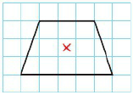
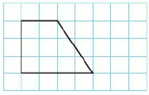
8 – Prior Knowledge Check
Page 240
Copy and rotate this shape 180° about the centre of rotation.
Copy this
shape.
Enlarge it
by scale
factor 2.

Slide 11
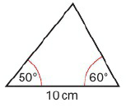
8 – Prior Knowledge Check
Page 240
Is the enlarged shape in Q9 similar or congruent to the original?
Draw this triangle accurately.

Slide 12
8 – Prior Knowledge Check
Page 240
* Challenge
Draw a grid with x- and y-axes from -5 to 5.
  Work out the coordinates of points needed to make
    a kite
    a trapezium with one line of symmetry.
  Draw the line of symmetry on each shape.
  The line of symmetry cuts each shape in half. Write down the coordinates of the vertices of
    one half of the kite
    one half of the trapezium.
  Give the coordinates from part c and the equation of the line of symmetry to one of your classmates. Can they use these to reproduce your original shapes?

Slide 13

8.1 – 3D Solids
Page 160
Objectives |  | Why Learn This?
Draw plans and elevations of 3D solids |  | Architectural drawings show plans and elevations of buildings.
Fluency
What are the dimensions of the top, side and front of this cuboid?
ActiveLearn - Homework, practice and support: Higher 8.1

Slide 14
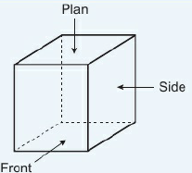
8.1 – 3D Solids
Page 240
On an isometric grid, draw
  a cube b. a cuboid
  a triangular prism.
Warm Up
Key Point 1
The plan is the view from above the solid.
The front elevation is the view of the front of the solid.
The side elevation is the view of the side of the solid.

Slide 15
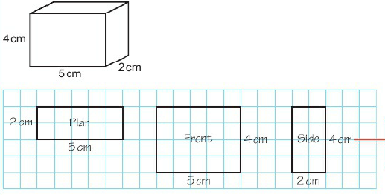
8.1 – 3D Solids
Page 241
Example 1
Draw the plan, front elevation and side elevation of this solid on squared paper.
Use a ruler.
Measure accurately.
Label the lengths
Questions in this unit are targeted at the steps indicated.

Slide 16


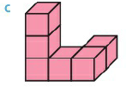
8.1 – 3D Solids
Page 241
On squared paper, draw and label the plan, front elevation and side elevation of these solids.
Problem-solving Here
is the side elevation
of a 3D solid. Sketch
three possible 3D
solids it could belong to.

Slide 17
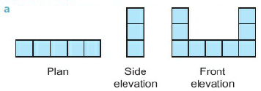
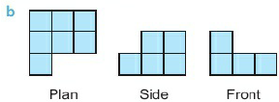
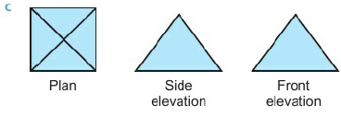
8.1 – 3D Solids
Page 241
Reasoning Sketch the solids represented by these plans and elevations.

Slide 18

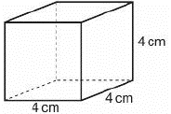
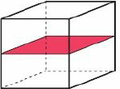
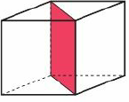
8.1 – 3D Solids
Page 242
Problem-solving / Reasoning Here Is a cube,
  Calculate the surface area of the cube,
  The cube is cut in half along the red plane.
  Sketch the plan, front elevation and side elevation of each of the new 3D solids.
  Calculate the surface area of each of the new solids,
  Repeat parts b and c for the cube cut along this red plane.
  Discussion Why does the surface area of the two parts not equal the surface area of the original cube?

Slide 19
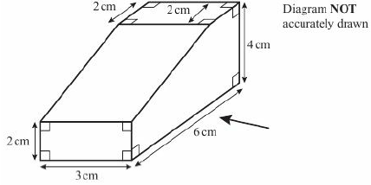
8.1 – 3D Solids
Page 242
6 – Exam-Style Questions
Here is a solid prism:
On a centimetre-square grid, draw an accurate side elevation of the solid prism from the direction of the arrow.
(2 marks)
March 2013, Q10, 5MB2H/01
Exam hint
Use a pencil and make sure the lines are dark enough so that an examiner can see them.

Slide 20
8.2 – Reflection and Rotation
Page 242
Objectives |  | Why Learn This?
Reflect a 2D shape in a mirror line. Rotate a 2D shape about a centre of rotation. Describe reflections and rotations. |  | Car mechanics and engineers need to know how far a part has rotated when checking engine parts.
Fluency
When you reflect a shape, are the object and image congruent? What about a rotation?
ActiveLearn - Homework, practice and support: Higher 8.2

Slide 21
8.2 – Reflection and Rotation
Page 242
Draw a coordinate grid from -5 to +5 on both axes. Draw these straight lines.
  y = -3 b. x = -4
  y = -2 d. y = -x
Warm Up
Key Point 2
Reflections and rotations are types of transformation.
Transformations move a shape to a different position.
To describe a reflection, you need to give the equation of the mirror line.
Key Point 3
An original shape is called an object. When the object is transformed, the resulting shape is called an image.

Slide 22
8.2 – Reflection and Rotation
Page 243
Draw a coordinate grid from -5 to +5 on both axes.
  Draw rectangle Q with vertices at coordinates (1,1), (1,3), (5,3), (5,1).
  Reflect rectangle Q in the x-axis. Label the image R.
  Reflect rectangle R in x = 1. Label the image S.
  Reflect rectangle S in the x-axis. Label the image T.
  Describe the single reflection that maps rectangle T onto rectangle Q.
Q2 hint - Use tracing paper to help.

Slide 23
8.2 – Reflection and Rotation
Page 243
Reasoning Draw a coordinate grid from -3 to +3 on both axes,
  Draw triangle A with coordinates (-1, -1), (-1,2), (2, -1).
  Reflect triangle A in the li ne y = 1. Label the image B.
  Reflect triangle A in the li ne y = x. Label the image C.
  Discussion What is special for triangle A about the line y = x? Explain how you could use this In part c.

Slide 24
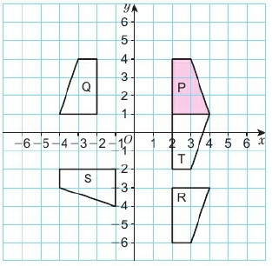
8.2 – Reflection and Rotation
Page 243
Describe the reflection that maps
  P onto Q b. P onto R
  P onto S d. P onto T.

Slide 25
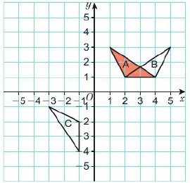
8.2 – Reflection and Rotation
Page 243
Describe the reflection that maps
  A to B b. A to C

Slide 26
8.2 – Reflection and Rotation
Page 244
Draw a coordinate grid from -5 to +5 on both axes,
  Draw shape A with vertices at coordinates (-1,2), (-1,4), (1,4), (1,2).
  Reflect shape A in the line y = x. Label the image B.
  Reflect shape A in the line y = -x. Label the image C.
  Reflect shape A in the z-axis. Label the image D.
  Describe the reflection that maps shape D to shape B.

Slide 27
8.2 – Reflection and Rotation
Page 244
Reasoning Draw a coordinate grid from -8 to +8 on both axes,
  Draw triangle A with coordinates (1,1), (1,5), (4,5).
  Rotate triangle A
    90° clockwise about (1,1)
    180° about (1,0)
    90° anticlockwise about (0,1)
    180° about (-2,1)
    90° clockwise about (2,5)
    180° about (2,3).
    Label your results i, ii etc.
    Discussion Why don't you need to give the direction for a rotation of 180°?
Q7 hint - Use tracing paper to help.

Slide 28
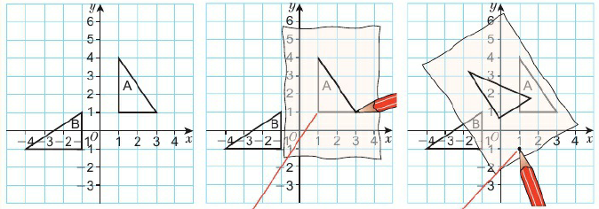
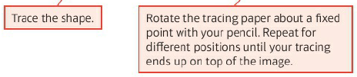

8.2 – Reflection and Rotation
Page 244
Key Point 4
O describe a rotation you need to give:
The direction to turn (clockwise or anticlockwise)
The angle to turn • The centre of rotation
Example 2
Describe the
rotation that
takes shape A
onto shape B.
Rotation anticlockwise 90⁰ about (1, -1)

Slide 29
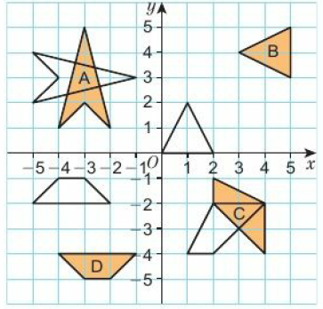
8.2 – Reflection and Rotation
Page 245
Describe the rotation that takes each shape to its image.

Slide 30
8.2 – Reflection and Rotation
Page 245
Problem-solving Draw a coordinate grid from -5 to +5 on both axes,
  Draw shape A with vertices at coordinates (1,1), (1,3), (3,3), (4,1).
  Reflect shape A in the line y = x. Label the image B.
  Reflect shape B in the (/-axis. Label the image C.
  Describe the transformation that takes shape A to shape C.
Reasoning 'A reflection in one axis followed by a reflection in the other axis is the same as a rotation.’
Decide whether this statement is: sometimes true, always true or never true.

Slide 31
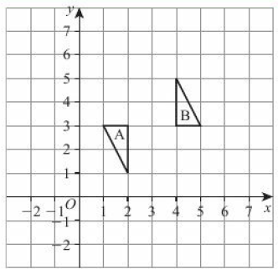
8.2 – Reflection and Rotation
Page 245
11 – Exam-Style Questions
Describe fully the single transformation that maps triangle A onto triangle B. (3 marks)
June 2012, Q9, IMA0/1H
Exam hint
The question is worth 3 marks which means you need to give 3 pieces of information about the transformation.

Slide 32
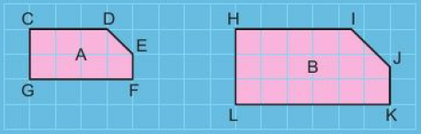
8.3 – Enlargement
Page 245
Objectives |  | Why Learn This?
Enlarge shapes by fractional and negative scale factors about a centre of enlargement. |  | Special effects artists use enlarged shapes when designing images for a background scene.
Fluency
What is the scale factor of the enlargement of shape A to shape B? Which vertex on shape B corresponds to F on shape A?
ActiveLearn - Homework, practice and support: Higher 8.3

Slide 33
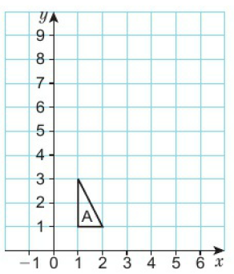
8.3 – Enlargement
Page 246
Copy this diagram and draw
  an enlargement with scale factor 3, centre (0,0)
  an enlargement with scale factor 1.5, centre (1,1).
Warm Up
Key Point 5
An enlargement is a transformation where all the side lengths of a shape are multiplied by the same scale factor.

Slide 34
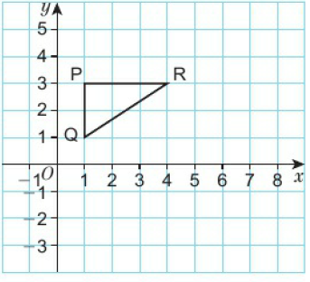
8.3 – Enlargement
Page 246
Copy the diagram. Enlarge the triangle by scale factor 2, with these centres of enlargement,
  (3,5) b. (4,3) c. (2,2)
Key Point 6
To describe an enlargement you reed to give the centre of enlargement and the scale factor.

Slide 35
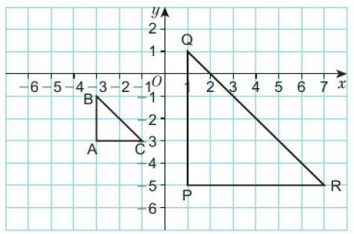
8.3 – Enlargement
Page 246
Triangle ABC has been enlarged to give triangle PQR.
  What is the scale factor of the enlargement?
  Copy the diagram.
  Join corresponding vertices on the object and the image with straight lines.
  Extend the lines until they meet at the centre of enlargement,
  Write down the coordinates of the centre of enlargement,
  Copy and complete to
  describe the enlargement
  from A to B.
  Enlargement by scale
  factor____, centre (___,___).

Slide 36
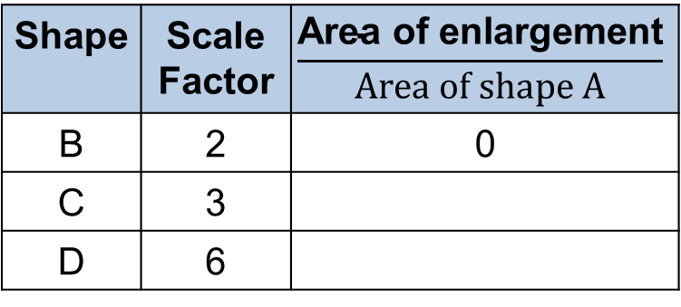
8.3 – Enlargement
Page 247
Problem-solving Draw a rectangle A, with base 3 cm and height
2 cm.
  Work out the area of the rectangle.
  Shape A is enlarged by scale factor 2 to make shape B. Work out the area of shape B.
  Shape A is enlarged by scale factor 3 to make shape C. Work out the area of shape C.
  Shape A is enlarged by scale factor 4 to make shape D. Work out the area of shape D.
  Copy and complete this
  table.
  Discussion When a shape is enlarged by scale factor k, what happens to its area?
Shape | Scale Factor | $$\frac{\text{Area} \text{of} \text{enlargement}}{Area of shape A}$$
B | 2 | 0
C | 3
D | 6
Key Point 7
When a shape is enlarged by scale factor k, the area is enlarged by scale factor k2.

Slide 37
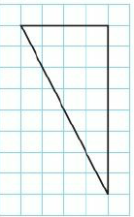
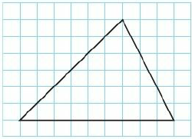
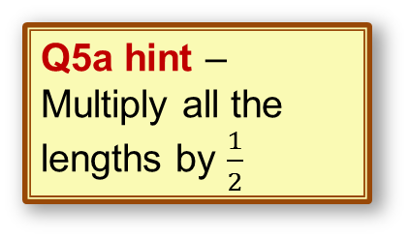
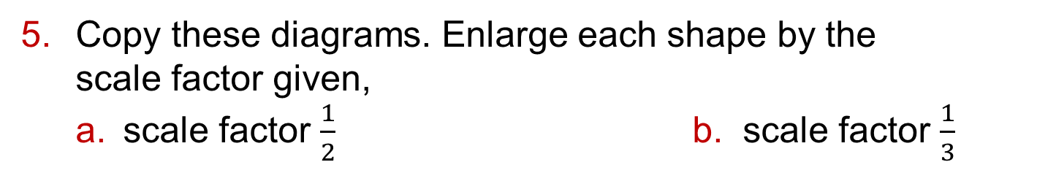
8.3 – Enlargement
Page 247
Copy these diagrams. Enlarge each shape by the
scale factor given,
  scale factor $\frac{1}{2}$ b. scale factor $\frac{1}{3}$
Q5a hint – Multiply all the lengths by $\frac{1}{2}$
Q5b hint –Divide the base and vertical height by 3
Key Point 8
To enlarge a shape by a fractional scale factor, multiply all the side lengths by the scale factor. When a centre of enlargement is given, multiply the distance from the centre to each point on the shape by the scale factor.

Slide 38
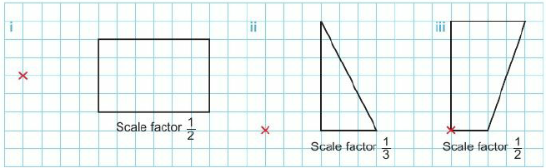
8.3 – Enlargement
Page 247
a. Copy and enlarge each shape by the given scale factor about the centre of
enlargement shown.
  Reasoning – When a shape is enlarged by a scale factor ½, is its area enlarged by scale factor (½)²? Explain.

Slide 39
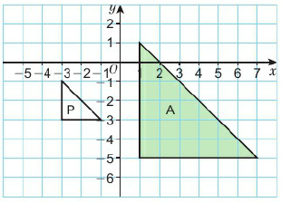
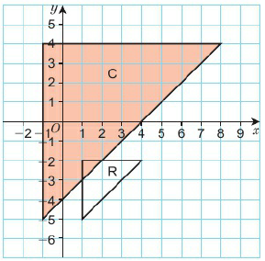
8.3 – Enlargement
Page 248
Problem-solving
  Describe the enlargement that maps shape A onto shape P.
  Describe the enlargement that maps shape C onto shape R.

Slide 40
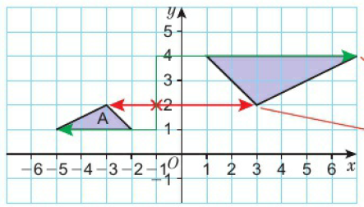
8.3 – Enlargement
Page 248
Key Point 9
A negative scale factor takes the image to the opposite side of the centre if enlargement.
Example 1
Enlarge triangle A by scale factor -2 about centre (-1, 2).
Count the squares from the centre of enlargement
Instead of 1 down, 4 left, go up 2 8 right
Instead of 2 left, go 4 right.

Slide 41

8.3 – Enlargement
Page 248
Draw a coordinate grid from -12 to +12 on both axes. Join the points (1,2), (4,4) and (4,1) to make a triangle. Enlarge the triangle
  by scale factor -2, centre of enlargement (-1, 0)
  by scale factor -2, centre of enlargement (-1, 3)
  by scale factor -2, centre of enlargement (4,4).
Reflect Jamie said, 'An enlargement always makes a shape bigger than the original shape.' Is Jamie correct? Explain your answer.

Slide 42
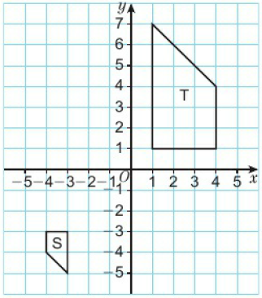
8.3 – Enlargement
Page 249
Problem-solving Describe fully the single transformation that maps shape S onto shape T.
Q9 strategy hint - Draw lines to find the centre.

Slide 43
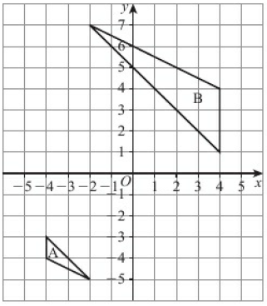
8.3 – Enlargement
Page 249
11 – Exam-Style Questions
Describe fully the single transformation that maps shape A onto shape B. (3 marks)
Exam hint
For 3 marks, give 3 pieces of information about the transformation.

Slide 44
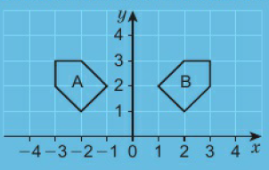
8.4 – Translations and Combinations of Transformations
Page 249
Objectives |  | Why Learn This?
Translate a shape using a vector. Carry out and describe combinations of transformations. |  | Interior designers draw a plan of a room and translate and transform furniture so that it fits well.
Fluency
Describe two possible transformations that could take shape A to shape B.
ActiveLearn - Homework, practice and support: Higher 8.4

Slide 45
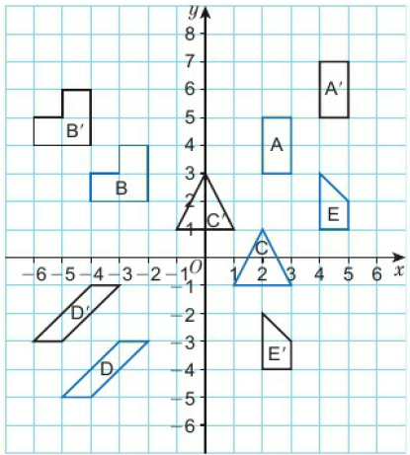
8.4 – Translations and Combinations of Transformations
Page 250
Describe the translation that moves each shape to its image.
Warm Up
Q1 hint - ◻squares left, ◻ squares right.

Slide 46
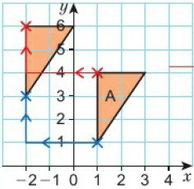
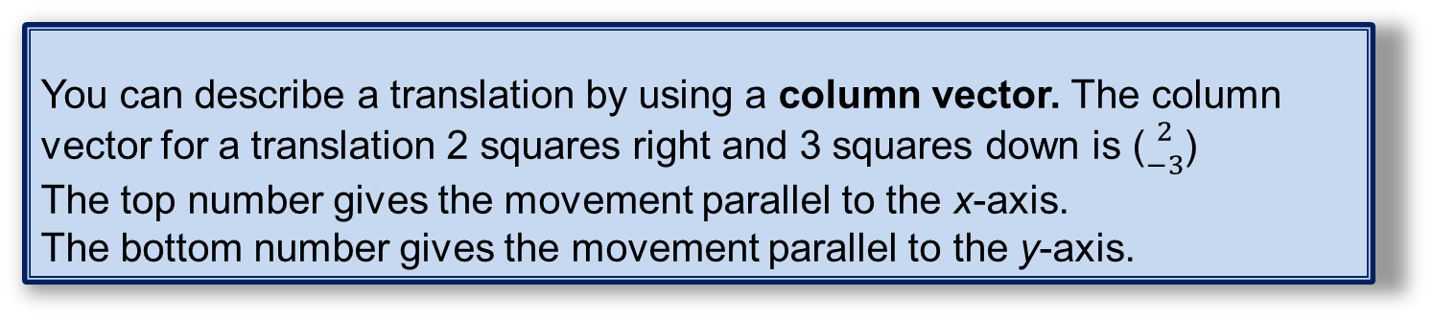
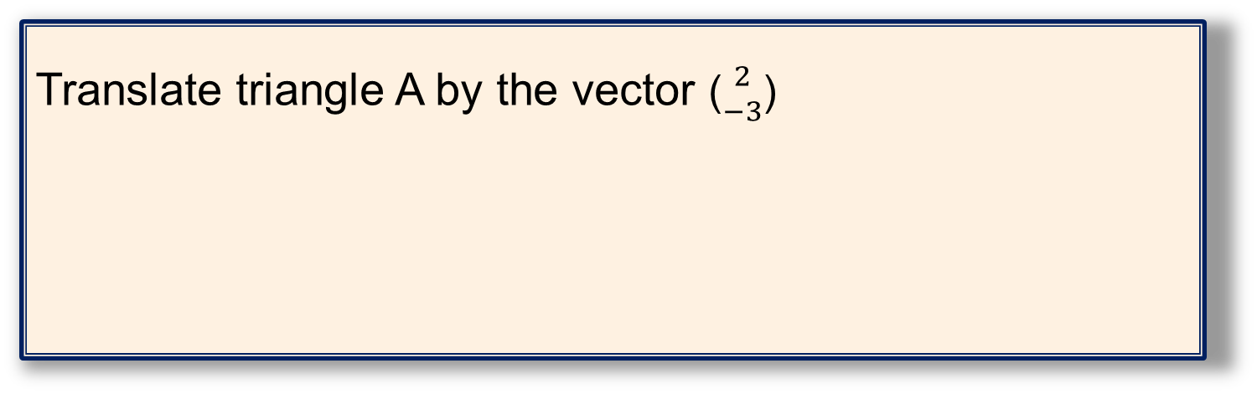
8.4 – Translations and Combinations of Transformations
Page 250
Key Point 10
In a translation, all the points on the shape move the same distance in the same direction.
Key Point 11
You can describe a translation by using a column vector. The column vector for a translation 2 squares right and 3 squares down is (${2 \atop −3}$)
The top number gives the movement parallel to the x-axis.
The bottom number gives the movement parallel to the y-axis.
Example 1
Translate triangle A by the vector (${2 \atop −3}$)
Move each point on the original shape 3 squares left and 2 squares up.

Slide 47
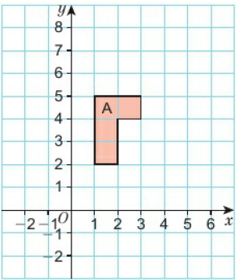
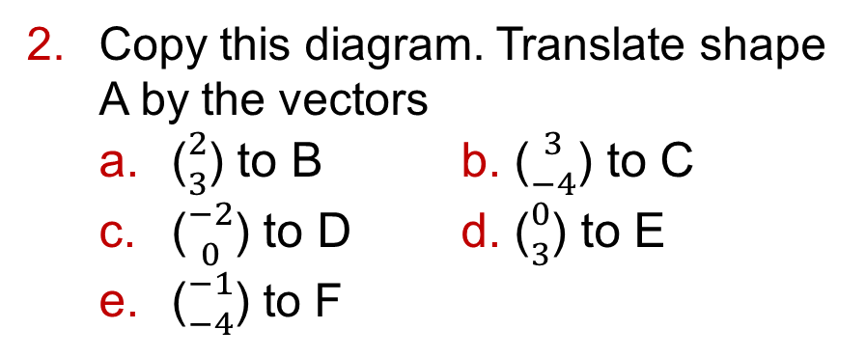
8.4 – Translations and Combinations of Transformations
Page 250
Copy this diagram. Translate shape A by the vectors
  (${2 \atop 3}$) to B b. (${3 \atop −4}$) to C
  (${−2 \atop 0}$) to D d. (${0 \atop 3}$) to E
  (${−1 \atop −4}$) to F

Slide 48
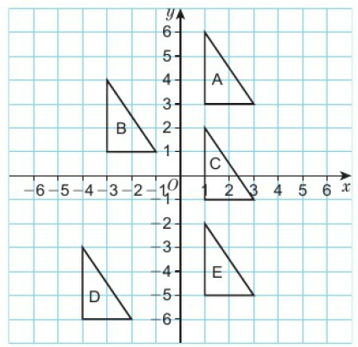
8.4 – Translations and Combinations of Transformations
Page 251
Describe these translations using column vectors.
  B to A
  A to C
  B to E d. D to E
  D to E
  E to D
  Discussion – How can you use your answer to part d to help you find the answer to part e?

Slide 49

8.4 – Translations and Combinations of Transformations
Page 251
Reasoning A shape is translated by vector (${a \atop b}$)
What vector would translate the shape back to its original position? Explain your answer.
Draw a coordinate grid from -6 to +6 on both axes.
  Plot a triangle with vertices at (1,1), (3,1) and (1, -2). Label the triangle P.
  i. Translate triangle P by vector QJ.
  Label the image Q.
    Translate triangle Q by vector (${1 \atop 4}$). Label the image R.
  Describe the translation of triangle P to triangle R, using a single vector.
Discussion What do you notice about the vectors in parts b and c?

Slide 50


8.4 – Translations and Combinations of Transformations
Page 251
a. Reasoning - A shape is translated by vector (${3 \atop 4}$) followed
by a translation by vector (${1 \atop −3}$)
What is the resultant vector?
  What is the resultant vector for a translation of (${a \atop b}$) followed by a translation of (${c \atop d}$)? Explain your answer.
Copy this diagram and shape A only on a coordinate grid from -6 to +6 on both axes.
  Translate shape A by vector (${3 \atop −2}$).
  Label the image C.
  Reflect shape B in the line y = -2.
  Label the image C.

Slide 51


8.4 – Translations and Combinations of Transformations
Page 252
Copy the diagram from Q7 and shape P only on a coordinate grid from -6 to +6 on both axes,
  Reflect shape P in the line
  y = 1. Label the image Q.
  Rotate shape Q through 180°, about point (1, -1). Label the image R.
  Translate shape R by vector (${2 \atop 4}$). Label the image S.
  Describe the reflection that maps shape P onto shape S.

Slide 52

8.4 – Translations and Combinations of Transformations
Page 252
Copy the diagram from Q7 and shape V only on a coordinate grid from -6 to +6 on both axes,
  Reflect triangle V in the line y = x. Label the image W.
  Translate triangle W by vector (${4 \atop 2}$). Label the image X.
  Rotate triangle X through 90° anticlockwise about point (-2,2). Label the image Y.
  Describe the single transformation that maps triangle V onto triangle Y.
Reflect Adam says, 'A shape and its transformed image are always congruent.' Do you agree with this statement? If not, give a counter example and explain your answer.
Q12 communication hint - A counter example is an example where the statement is not true.

Slide 53

8.4 – Translations and Combinations of Transformations
Page 252
Problem-solving / Reasoning A company has based Its
logo on a triangle.
Draw a coordinate grid
from -6 to +6 on both
axes,
  Plot the points (0,0),
  (1,2) and (2,2) and join them to make a triangle.
  Reflect the triangle in the line y = x.
  Draw more reflections to complete the logo,
  The company now wants to make a version of the logo 12 units tall, to go on a desk sign. What transformation will convert the original logo into the larger one?

Slide 54

8.4 – Translations and Combinations of Transformations
Page 252
11 – Exam-Style Questions
Describe fully the
single
transformation
that maps triangle
P onto triangle Q.
(2 marks)
Reflect triangle
P in the x-axis
and label the image S.
Then translate shape S by vector and label the image R. (3 marks)
Describe the single transformation that maps triangle Q onto triangle R.
(2 marks)
Exam hint - Make sure you label each triangle with the correct letter.

Slide 55
8.5 – Bearings and Scale Drawings
Page 253
Objectives |  | Why Learn This?
Draw and use scales on maps and scale drawings. Solve problems involving bearings. |  | Bearings are used in plane and boat navigation as the north line is fixed.
Fluency
Convert • 50000 cm to metres • 5000 m to kilometres
ActiveLearn - Homework, practice and support: Higher 8.5

Slide 56

8.5 – Bearings and Scale Drawings
Page 253
a. On a scale drawing, 1cm represents 2m. What does 10cm on the drawing represent?
  On a map, 1 cm represents 10 km. What is the length on the map for a real-life distance of 25 km?
a. Make an accurate scale drawing of his triangular
garden. Use a
scale of 1 cm
to 1.5 m.
  What is the
  perimeter of the
  real-life garden?
Warm Up
Q2 hint - Use a ruler and a protractor.

Slide 57


8.5 – Bearings and Scale Drawings
Page 253
Describe the bearing of B from A:
Plot a point A. Plot a point B on a bearing of 285° from A.
Warm Up
Q3 hint - A bearing always has three digits, for example 090°.

Slide 58


8.5 – Bearings and Scale Drawings
Page 253
Real / Problem-solving Here is a map of a town.
The real-life distance between the school and the library 'as the crow flies' is 480 m.
  What scale has been used on the map?
  From the map, estimate the distance as the crow flies between
    the church and the park
    the church and the school,
  John can walk 100m in 40 seconds.
  How long will it take him to walk from the library to the school?
  Write your answer in minutes.

Slide 59
8.5 – Bearings and Scale Drawings
Page 248
Example 5
A map has a scale of 1:50000.
What is the real-life distance in kilometres for 6cm on the map?
Map Real life
1 : 50000
6 : 300000'
6 cm represents 6 x 50000 = 300000cm.
300000cm ÷ 100 = 3000 m 3000 m ÷ 1000 = 3 km
Map ratios have no units. 1:50000 means 1 cm represents 50000cm.
x6 x6
Convert to m.
Convert to km.

Slide 60
8.5 – Bearings and Scale Drawings
Page 254
Paul is using a map with a scale of 1:50000.
He measures these distances.
What are the distances in real life? Write your answers in kilometres,
  10cm b. 6cm c. 2.5cm
The scale on a map is 1:200000.
What is the distance on the map, in cm, for a real distance of
  20 km b. 10 km c. 8 km
Q7 hint –
Map Real Life
1cm : 200 000cm = ◻m = ◻km

Slide 61

8.5 – Bearings and Scale Drawings
Page 254
Real The scale on a map is 1:25 000.
  On the map, the distance between two schools is 10 cm.
  Work out the real distance between the schools. Give your answer in km.
  The real distance between two farms is 4 km. Work out the distance between the farms on the map. Give your answer in cm.
Real
  Calculate the distance
  in km between
    Galway and Sligo
    Dublin and Belfast
  Which place is 180km
  from Dublin and 150km
  from Belfast?

Slide 62

8.5 – Bearings and Scale Drawings
Page 255
Modelling The
diagram shows
two satellites A
and B detecting
an aeroplane (C).
  Make an accurate scale drawing using a scale of 1:2 000000.
  Work out the real distances AC and CB.
Real / Problem-solving The distance between Manchester Airport and Luton Airport is 215 km.
The bearing of Luton Airport from Manchester Airport is 135°.
Make an accurate scale map of the locations of the two airports, using a scale of 1 cm to 40 km.
Q11 strategy hint – Draw a sketch first

Slide 63
8.5 – Bearings and Scale Drawings
Page 255
Problem-solving A plane is 80 km west of an airport.
The plane then flies on a bea ring of 050° for 120 km.
  Make an accurate scale drawing. Use a scale of 1 cm to 20 km.
  What is the bearing of the airport from the plane?
Problem-solving A ship sails for 24 km on a bearing of 060°.
It then turns and sails for 18 km on a bearing of 160°.
  Use a scale of 10 cm to 30 km to draw an accurate scale drawing of the journey of the ship,
  How far is the ship from its starting point to the nearest kilometre?
  What is the bearing the ship should sail to return to its starting point?

Slide 64


8.5 – Bearings and Scale Drawings
Page 255
Real / Problem-solving The bearing of Palermo Airport from Paris Airport is 143°. Calculate the bearing of Paris Airport from Palermo Airport.

Slide 65
8.5 – Bearings and Scale Drawings
Page 255
Problem-solving a. The bearing of B from A is 080°. Work out the bearing of A from B.
  The bearing of C from D is 230°. Work out the bearing of D from C.
Q15 strategy hint – Draw a diagram
16 – Exam-Style Questions
The diagram shows the N
position of two boats, B and C.
Boat T is on a bearing of 060° from boat B.
Boat T is on a bearing of 285° from boat C.
Draw an accurate diagram to show the position of boat T. Mark the position of boat T with a cross (X).
Label it T. (3 marks)
June 2013, Q6, 5MB3H/0J
N
C
N
B

Slide 66
8.6 – Constructions 1
Page 256
Objectives |  | Why Learn This?
Construct triangles using a ruler and compasses. Construct the perpendicular bisector of a line. Construct the shortest distance from a point to a line using a ruler and compasses. |  | Traditional architects use compasses and rulers to draw accurate scale drawings.
Fluency
What do these words mean: perpendicular, bisect, arc?
ActiveLearn - Homework, practice and support: Higher 8.6

Slide 67


8.6 – Constructions 1
Page 256
Make an accurate drawing of this triangle.
Reasoning - Make an accurate drawing of a triangle with these three angles.
Discussion – Can you draw a different triangle with the same angles.
Warm Up

Slide 68

8.6 – Constructions 1
Page 256
Key Point 13
To construct means to draw accurately using a ruler and compasses.
Example 6
Construct a triangle with sides 11cm, 8cm and 6cm.
Sketch the triangle first then Draw the 8cm line.
Open your compasses to 6cm. Place the point at one end of the 8cm line. Draw an arc.
Open your compasses to 11cm. Draw another arc from the other end of the 8 cm line. Make sure your arcs are long enough to intersect.
Join the intersection of the arcs to each end of the 8cm line.
Don't rub out your construction marks.

Slide 69

8.6 – Constructions 1
Page 257
Construct an
accurate drawing
of this triangle.
Construct each triangle ABC.
  AB = 5cm, BC= 6cm, AC = 7cm
  AB = 10cm, AC = 5cm, CB = 6cm
  AB = 8.5 cm, BC = 4cm, AC = 7.5 cm
Construct an equilateral triangle with sides 6.5cm.
Check the angles using a protractor.
Q4 strategy hint - Sketch each triangle first and label the lengths.

Slide 70

8.6 – Constructions 1
Page 257
Reasoning Explain why it is impossible to construct triangle with sides 6cm, 4.5cm, 11cm.
Real Construct an accurate scale drawing of this skateboard ramp. Use a scale of 1 cm to 20 cm.
Q6 hint – Try the construction.

Slide 71


8.6 – Constructions 1
Page 257
Real The diagram shows the end elevation of a house roof.
Using a scale of 1 cm to 2 m, construct an accurate scale
drawing of this
elevation.
Real / Problem-solving This chocolate box is in the shape of a tetrahedron. Each face is an equilateral triangle with side length 24cm.
Construct an
accurate net for
the box.
Use a scale of
1 cm to 4 cm.

Slide 72


8.6 – Constructions 1
Page 258
Key Point 14
A perpendicular bisector cuts a line in half at right angles.
Example 6
Draw a line 9cm
long. Construct
its perpendicular
bisector.
Use a ruler to draw the line.
Open your compasses to more than half the length of the line.
Place the point on one end of the line and draw an arc above and below.
Keeping the compasses open to the same distance, move the point of the compasses to the other end of the line and draw a similar arc.
Join the points where the arcs intersect.
Don't rub out your construction marks.
This vertical line is the perpendicular bisector.

Slide 73
8.6 – Constructions 1
Page 258
a. Draw a line segment AB 7 cm long. Construct the perpendicular bisector of AB.
  Use a ruler and protractor to check that it bisects your line at right angles.
  Mark any point P on your perpendicular bisector. Measure its distance from A and from B. Discussion How can you find a point the same distance from A as from B?
Problem-solving Two ships, S and T, are 50 m apart,
  Using a scale of 1 cm to 5 m, draw an accurate scale drawing of the ships.
  A lifeboat is equidistant from both ships.
  Construct a line to show where the lifeboat could be.
Q11 communication hint – ‘Equidistant’ means 'at equal distance from'.

Slide 74

8.6 – Constructions 1
Page 258
Follow these instructions to draw the perpendicular from point P not on the line to the line AB.
  Draw a line segment AB and point P not on the line,
  Open your compasses and draw an arc with centre P. Label the two points where it intersects the line AB S and T.
  Construct the perpendicular bisector of the line ST.
  Discussion What is the shortest distance from P to AB?

Slide 75

8.6 – Constructions 1
Page 258
Follow these instructions to construct the perpendicular at point P on a line,
  Draw a line segment and point P on the line.
  Open your compasses. Put the point on P and draw arcs on the line on either side of point P.
  Label the points where they intersect the line X and Y. , (
  Construct the perpendicular bisector.
Key Point 15
The shortest path from a point to a line is perpendicular to the line.

Slide 76

8.6 – Constructions 1
Page 259
Problem-solving A swimmer wants to swim the shortest distance to the edge of a swimming pool. The scale is 1 cm to 5 m.
  Trace the diagram and construct the shortest path for the swimmer to swim to each side of the swimming pool.
  Work out the
  difference in
  the distances.
  The swimmer
  swims 2 m
  every second.
  How long would the shortest distance take?

Slide 77
8.7 – Constructions 2
Page 256
Objectives |  | Why Learn This?
Bisect an angle using a ruler and compasses. Construct angles using a ruler and compasses, Construct shapes made from triangles using a ruler and compasses. |  | Constructing shapes accurately reduces errors, which can be costly and even dangerous.
Fluency
Use a protractor to draw an angle of 45°.
ActiveLearn - Homework, practice and support: Higher 8.7

Slide 78
8.7 – Constructions 2
Page 259
a. Construct a triangle with sides 10cm, 8cm, 6cm using a ruler and compasses,
  What type of triangle have you drawn?
a. Construct an equilateral triangle with side 5cm using a ruler and compasses,
  What is the size of each interior angle in your triangle?
Warm Up

Slide 79

8.7 – Constructions 2
Page 259
Key Point 16
An angle bisector cuts an angle exactly in half.
Example 6
Draw an angle of 80°. Construct the angle bisector.
Draw an angle of 80° using a protractor.
Open your compasses and place the point at the vertex of the angle. Draw an arc that crosses both arms of the angle.
Keep the compasses open to the same distance. Move them to one of the points where the arc crosses an arm. Make an arc in the middle of the angle.
Do the same for where the arc crosses the other arm.
Join the vertex of the angle to the point where the two small arcs intersect. Don't rub out your construction marks. This line is the angle bisector.

Slide 80

8.7 – Constructions 2
Page 260
For each angle
  trace the angle
  construct the angle bisector using a ruler and compasses
  check your two smaller angles using a protractor,

Slide 81
8.7 – Constructions 2
Page 260
Problem-solving Use a ruler and compasses to construct these angles,
  90° b. 45°
Problem-solving Use a ruler and compasses to construct these angles,
  60° b. 30°
Problem-solving Use a ruler and compasses to construct a 120° angle.
Q4a hint - What angle will you get when you bisect a straight line?

Slide 82
8.7 – Constructions 2
Page 260
Problem-solving Use a ruler and compasses to construct these angles,
  90° b. 45°
Problem-solving Use a ruler and compasses to construct these angles,
  60° b. 30°
Problem-solving Use a ruler and compasses to construct a 120° angle.
Q4a hint - What angle will you get when you bisect a straight line?

Slide 83

8.7 – Constructions 2
Page 260
Real / Problem-solving - A gardener wants to divide a rectangular garden into two sections. The triangular section will be decking and the rest of the garden will be grass.
Make a scale drawing of the rectangular garden. Use a scale of lcm to 4 m.
Use a ruler and compasses to construct an angle of 30°.
Calculate the area of the decking.
Q7a hint - To draw a right angle at a vertex, you need to extend the line beyond the vertex. Then mark two points on the line an equal distance either side of the point and construct
the perpendicular bisector.

Slide 84

8.7 – Constructions 2
Page 260
Real / Problem-solving Four pairs of wires connect a flagpole to the ground. The lower wire BD bisects angle ABC.
  Construct a scale drawing. Use a scale of 1 cm to 1 m.
  Measure the length of the wire BD.
  How much wire is used in total?

Slide 85

8.7 – Constructions 2
Page 261
Problem-solving
  Use a ruler, protractor and compasses to construct the triangle ABC.
  Construct a line that is perpendicular to AB and passes through C.
  Calculate the area of the triangle to the nearest cm.

Slide 86

8.7 – Constructions 2
Page 261
Problem-solving - Construct this trapezium made from equilateral triangles using a ruler and compasses.
Problem-solving Draw a regular octagon in a circle of radius 5cm.
Q13 hint - What angle will you need to construct from the centre to two consecutive points on the circumference?

Slide 87

8.7 – Constructions 2
Page 261
a. Construct a triangle with sides
5cm, 8cm and 10cm.
  Construct the
  bisector of
  each angle.
  The angle
  bisectors cross at the same point.
  Label this point 0.
  Construct the perpendicular to one of the sides from the point you found in part c. Label the point where the perpendicular meets the side A.
  Draw a circle with radius OA.
  What do you notice about your circle?

Slide 88

8.7 – Constructions 2
Page 261
Reasoning
  Draw a circle with
  centre O and radius
  5 cm.
  Mark a point A on its
  circumference,
  Keep the compasses the same size as the radius and draw an arc from point A.
  Keeping the compasses the same, repeat from point B.
  Repeat until you have six points on the circumference,
  Join the points and name the shape that you have drawn.
  Discussion What is the size of angle AOB? Explain why.

Slide 89

8.8 – Loci
Page 262
Objectives |  | Why Learn This?
Draw a Locus Use Loci to solve problems. |  | Telephone companies use loci to pan where they will put their telephone masts.
Fluency
Are all the points on the dotted line the same distance from the solid line?
ActiveLearn - Homework, practice and support: Higher 8.8

Slide 90
8.8 – Loci
Page 262
Draw a small cross. Mark ten points which are 4 cm from it. What shape do they make?
Warm Up
Key Point 17
A locus is the set of all points that obey a certain rule. Often a locus is a continuous path.
A circle is the locus of a point that moves so that it is always a fixed distance from a fixed point.
Real A teacher asks some children to sit 5 m from her while she reads a story. Sketch the locus of where the children are sitting.

Slide 91

8.8 – Loci
Page 262
Problem-solving Draw a line 6cm long.
Draw the locus of all points which are 3 cm from the line.
Real / Problem-solving The diagram shows a fenced area in a park,
  Draw a plan of the fenced area using a scale of 1 cm to 5 m.
  A runner runs round the fenced area,
  staying exactly 10m from the fence,
  Construct the
  locus of his path.
Q3 hint - First use compasses to draw points 3 cm from each end.
Q4 hint - Think carefully about what happens at the corners.

Slide 92
8.8 – Loci
Page 262
Reasoning / Problem-solving
  Draw two points 10 cm apart and label them A and B.
  i. Mark a point which is 5cm from A and 5cm from B.
  ii. Mark two points which are 6cm from A and 6 cm from B.
  iii. Mark two points which are 7 cm from A and 7 cm from B.
  Join the points with a straight line.
  Discussion Can you use this line to show all the points that are equidistant from A and B?
Q5 communication hint - Points that are the same distance from points A and B are equidistant from A and B.

Slide 93
8.8 – Loci
Page 262
Problem-solving - A library is to be built equidistant from two towns, Arton and Borham. The towns are 2 km apart.
Using a scale of 1 cm to 250 m, construct the locus of the places where the library can be built.
Key Point 18
Points equidistant from two points lie on the perpendicular bisector of the line joining the two points.

Slide 94

8.8 – Loci
Page 263
Key Point 19
Points equidistant from two lines lie on the angle bisector.
Clare wants to place a lamp in her living room so that it is equidistant from the two marked walls.
  Copy the diagram using a scale of 1 cm to 2 m.
  Construct the locus of the places where she can position the lamp.

Slide 95

8.8 – Loci
Page 263
Problem-solving This rectangle is rotated about D. Copy the diagram.
The rectangle is then rotated 90° clockwise about C. Add this to the diagram,
  Draw the locus of vertex A.
  Draw the locus of vertex B.

Slide 96

8.8 – Loci
Page 263
Example 9
A and B are two points 4cm apart.
Shade the points that are less than 3 cm from A and less than 2 cm from B.
Draw a circle at A with radius 3 cm. All the points inside this circle are less than 3 cm from A.
Draw a circle at B with radius 2cm. All the points inside this circle are less than 2cm from B
Shade the region which satisfies both rules.

Slide 97
8.8 – Loci
Page 263
Real / Problem-solving Radio masts A and B are 120km apart.
The bearing of radio mast B from radio mast A is 120°.
The radio masts each transmit a signal over a distance of 80 km.
Draw an accurate scale drawing of the radio masts using a scale of 1 cm to 20 km. Shade the region which can receive signals from both radio masts.
A graph x² + y²= 16 shows the boundary of the region covered by a fire engine, where x and y are in km.
  Draw a coordinate grid from -5 to +5 on both axes. Plot the graph,
  What area does the fire engine cover?

Slide 98

8.8 – Loci
Page 264
10 – Exam-Style Questions
Here is a map.
The map shows
two towns,Burford
and Hightown.
A company is
going to build a
warehouse.
The warehouse will be less than 30 km from Burford and less than 50 km from Hightown.
Shade the region on the map where the company can build the warehouse.
(3 marks)
Nov 2012, Q10,1MA0/1H
Exam hint
Use a pair of compasses and make sure the pencil lines are dark enough for an examiner to see

Slide 99

8.8 – Loci
Page 263
Real / Problem-solving - Make an accurate scale drawing of this garden. Use a scale of 1cm to 4m.
A tree can be planted between 10 m and 4 m from corner C.
It must be planted at least 14 m from the house.
Accurately shade the region where the tree could be planted.

Slide 100

8.8 – Loci
Page 263
Problem-solving - ABCD is a square of side 8cm.
Copy the diagram. Shade the region that is less than 5cm from A and closer to side BC than to side CD.
Q12 hint - Use the angle bisector.

Slide 101

8 – Problem Solving: Under Construction
Page 265
Objectives
Use a ruler and compasses to construct given figures.
Engineers, architects and designers can use geometric constructions when manually drafting diagrams.
By combining the constructions you have met in this chapter, construct a protractor on a piece of plain paper. Your labelled angles should go up in multiples of 15 degrees and range from 0 to 180 degrees.
Q1 hint - Start by constructing a perpendicular bisector.

Slide 102
8 – Problem Solving: Under Construction
Page 265
In lesson 8.7 Q12 you learned how to construct a regular hexagon inside a circle.
Extend this method to construct a regular dodecagon (12 sides).
How could you use your square and adapt method you used to answer Q2 to construct a regular octagon?
Q2 hint - You will need to construct three perpendicular bisectors.
Q4 hint - You might start by constructing a square with all of its vertices on a circle.

Slide 103

8 – Problem Solving: Under Construction
Page 265
Follow these instructions to construct a square.
  Draw one side of your square, AB. Extend this line segment through B to help you construct a perpendicular bisector at B.
  Set the width of your
  compasses to the
  length of AB. With the point of
  your compasses at B, draw an
  arc through the perpendicular
  bisector to find vertex C.
  Finally, set the point of your compasses at A and then C, drawing an arc each time to locate the final vertex of the square. Label the intersection of these arcs D and draw in the remaining lines.
Which other regular polygons could you construct by adapting this method?

Slide 104


8 – Check-up
Page 266
2. Check up
Log how you did on your Student Progression Chart
Transformations
Enlarge this shape by scale factor $\frac{1}{3}$ with centre of enlargement S.

Slide 105

8 – Check-up
Page 266
Transformations
a. Describe the reflection that maps shape P onto shape Q.
  Describe the rotation that maps shape Q onto shape R.
  Use a vector to describe the translation that maps shape R onto S.

Slide 106

8 – Check-up
Page 266
Describe fully the transformation that maps
  shape A onto shape B
  shape A onto shape C
  shape A onto shape D..

Slide 107


8 – Check-up
Page 267
a. Copy the diagram on a coordinate grid from -6 to +6 on
both axes. Reflect shape A in the line y = -1. Label the image B.
  Rotate shape B by 180° about
  point (2,0). Label the image C.
  Translate shape C by vector (${−6 \atop −2}$)
  Label the image D.
  Describe fully the single
  transformation that maps shape A onto shape D.

Slide 108

8 – Check-up
Page 267
Drawings and bearings
Draw the plan, front elevation and side elevation of this shape.
A map has a scale of 1:100000.
Find in cm the distance on the map for a real distance of A km.
The bearing of a ship from a lighthouse is 110°. What is the bearing of the lighthouse from the ship?

Slide 109
8 – Check-up
Page 267
A plane flies 250 km from an airport on a bearing of 130°. The plane then turns and travels for 200 km on a bearing of 050°.
  Using a scale of lcm to 50 km, draw an accurate scale drawing of the flight of the plane,
  Find the bearing that the plane must travel on to return to the airport.
Constructions and loci
Draw a line 10cm long. Construct the perpendicular bisector using a ruler and compasses.

Slide 110


8 – Check-up
Page 267
Trace this angle. Bisect the
angle using a ruler and
compasses.
Three radio stations can transmit signals up to 100km.
  Using a scale of 1cm to 20km, construct a triangle with the radio stations at the corners of the triangle.
  Shade the region where someone could hear all three radio stations.

Slide 111
8 – Check-up
Page 268
How sure are you of your answers? Were you mostly: Just guessing ☹
Feeling doubtful 😐
Confident ☺
What next? Use your results to decide whether to strengthen or extend your learning.
* Challenge
What regular polygons can
you construct using only
ruler and compasses?
Reflect

Slide 112

8 – Strengthen
Page 268
8. Strengthen
Joanne has started to reflect the triangle in the line y = x.
  Copy the diagram,
  Turn the page so the mirror line is vertical and continue the reflection,
  Trace your completed diagram.
  Fold your diagram along the line y = x.
  What happens to the image and the object?
Q1 hint – Reflect each vertex in the mirror line.

Slide 113

8 – Strengthen
Page 268
Draw a coordinate grid from -4 to +4 on both axes,
  Plot and join the points (-1,1), (-1,4), (1,4), (1,1).
  Draw the line y = -x.
  Reflect the shape from part a in the line y = -x.
Write as a column vector
  3 right, 2 up b. 5 right, 1 up
  2 right, 1 down d. 3 left, 2 up
  6 left, 3 down f. 3 right, 4 down
Q4 hint – Q4 hint The vector is (${\text{horizontal} \text{movement} \atop \text{vertical} \text{movement}}$)
Left ← and down ↓ are negative.

Slide 114

8 – Strengthen
Page 268
Shape A is reflected to give image B.
Copy and complete this sentence. Shape A is reflected in the line
y =_______ to give image B.
Q3 hint – Join corresponding vertices on the object and the image and find the midpoints.

Slide 115

8 – Strengthen
Page 269
Describe the translation that takes
  A to B b. A to C
  A to D d. A to E

Slide 116

8 – Strengthen
Page 269
This triangle has been rotated through 90°
Is A, B or C the centre of rotation?
Q6 hint - Use tracing paper to help.

Slide 117

8 – Strengthen
Page 269
Describe the rotation that takes shape A to
  shape B
  Rotation of____° ___________ about (___, _____)
  shape C c. shape D
Q7 hint - You need to give angle and direction of rotations and the centre of rotation. No direction is needed for rotations of 180°.

Slide 118

8 – Strengthen
Page 269
Fernando has started to enlarge this rectangle by scale factor ½ about the centre of enlargement P.
  Copy the diagram - Work out the horizontal and vertical distances from P to points A and B. Halve them and mark the new points,
  Repeat for points C and D.
  Plot the new points and join them up.
Q8 hint - Check that the lengths on the enlargement are half as long as the original.
Q8 hint - A' is the position of A after the enlargement.

Slide 119

8 – Strengthen
Page 270
Copy this diagram.
Complete the workings to enlarge the shape by scale factor -2 about centre of enlargement Y.
Q9 hint - The negative sign tells you to change direction.

Slide 120

8 – Strengthen
Page 270
Copy this diagram in the top right
of a 25 x 20 square grid.
Enlarge the shape by
scale factor -3 about
centre of enlargement O.
Copy and complete the list of
information needed to describe:
Reflection line of reflection
Rotation _______, ____________ and _________
Translation ________ and ____________ (or ________)
Enlargement ________ and _________

Slide 121

8 – Strengthen
Page 270
Drawings and bearings
This solid is made from cubes.
  Which is the plan?
  Which is the side elevation?
  Which is the front elevation?

Slide 122


8 – Strengthen
Page 271
Simeon started to draw the plan and elevations of this solid.
Copy and complete Simeon’s drawings.
Q2 hint – In the question, the side elevation has been shaded.

Slide 123

8 – Strengthen
Page 271
A map has a scale of 1:50000.
What real distances represent a map distance of:
  2 cm b. 5 cm
  12cm d. 8.5 cm?
Q3 hint – 1 cm represents 50000 cm = 0.5 km.

Slide 124

8 – Strengthen
Page 271
A map has a scale of 1:300000.
What distances on the map represent a real-life distance of
  9 km b. 21km
  30 km d. 22.5 km?
Reasoning The bearing of B from A is 115°. Copy and complete the working to find the bearing of A from B. Give the reason for each step.
x = ◻° (________________)
y = 360 - x (________________)
= 360 - ◻° = ◻°
Bearing of A from B is ◻°.
Q4 hint - 1 cm represents 300 000cm = 3 km. Draw a number line like the one in Q3.

Slide 125

8 – Strengthen
Page 271
Problem-solving A ship sails 20 km from port on a bearing of 050°. It then turns and sails for 30 km on a bearing of 160°.
  Copy and complete the sketch of the ship's journey.
  Make an accurate scale drawing using a scale of 1 cm to 5 km.
  Use your diagram to work out
    how far the ship is from port to the nearest km
    the bearing the ship needs to sail on to get back to port.
Q6a communication hint - A sketch is not an accurate drawing.

Slide 126
8 – Strengthen
Page 271
Problem-solving A ship sails 20 km from port on a bearing of 050°. It then turns and sails for 30 km on a bearing of 160°.
  Copy and complete the sketch of the ship's journey.
  Make an accurate scale drawing using a scale of 1 cm to 5 km.
  Use your diagram to work out
    how far the ship is from port to the nearest km
    the bearing the ship needs to sail on to get back to port.
Q6c hint - Complete the triangle you drew in part b. Use the third side to find the distance and bearing
Q6a communication hint - A sketch is not an accurate drawing.

Slide 127

8 – Strengthen
Page 272
Constructions and loci
Follow these instructions to accurately construct a triangle with sides 6cm, 7 cm and 10cm.
Draw a line 7 cm long. Construct the perpendicular bisector.
Q1 hint - When you are asked to construct, use only a ruler and compasses.

Slide 128

8 – Strengthen
Page 272
Construct this triangle.
Use a protractor to draw an angle of 70°. Follow these instructions to construct the angle bisector.
7cm
8cm
9cm

Slide 129





8 – Strengthen
Page 272
Draw a line 12cm long. Follow these instructions to construct the perpendicular bisector.
Draw the line.
Open your compasses to more than the length of the line.
Draw the first arc.
Draw the second arc.
Draw the perpendicular bisector.
Q3 strategy hint –
Remember
the diagram
Q3 hint - Check by measuring that the angle is 90° and that the line is cut in half.

Slide 130

8 – Strengthen
Page 273
Use a protractor to draw an angle of 100°. Construct the angle bisector using a ruler and compasses.
a. Draw a dot in the middle of a blank piece of paper. Draw as many dots as you can exactly 4cm from your dot.
  What shape have you created?
  Copy and complete this sentence.
  Points that are equidistant from a centre make a _________ .
Q6 strategy hint –
Remember the diagram

Slide 131
8 – Strengthen
Page 273
Draw two crosses 6cm apart. Label them A and B.
  Mark all the points which are 4 cm from cross A.
  Shade lightly the region that is less than 4 cm from A.
  Mark all the points which are 4 cm from cross B.
  Shade lightly the region that is less than 4 cm from B.
  Shade darkly the region which is less than 4 cm from cross A and less than 4 cm from cross B.
Q8c hint - Shade darkly the region that has been lightly shaded from both A and B.

Slide 132
8 – Extend
Page 273
8. Extend
Problem-solving Draw a coordinate grid from -5 to +5 on both axes. Join the points (1,1), (1, 3) and (4,1) to make triangle M.
  Enlarge triangle M by scale factor -1 about the origin. Label the new triangle N.
  What rotation also maps triangle M onto triangle N?
  Does this always work? Try other shapes.
Problem-solving Triangle P with vertices at (-1, 0), (-1,3), (1,0) is transformed to give triangle Q with vertices at (-1,0), (-1, -6), (-5,0).
Describe fully the single transformation that maps triangle P onto triangle Q.

Slide 133
8 – Extend
Page 273
Problem-solving Draw a coordinate grid from -4 to +4 on both axes,
  Plot the points A (1,2), B (3,4), C (2, -1).
  Reflect points A, B and C i n the x-axis.
  What do you notice about the coordinates of A, B and C when they are reflected in the x-axis?
  Repeat parts a and b, reflecting in the y-axis,
  What would be the coordinates of the point (p, q) if it was reflected in
    the x-axis ii. the y-axis
    the x-axis, then the y-axis?

Slide 134
8 – Extend
Page 273
Problem-solving Draw a coordinate grid from -4 to +4 on both axes,
  Plot the points A (1,3), B (-4, -2), C (-1, 3), D (1, -2).
  Reflect points A, B, C and D in the line y = x.
  Reflect points A, B, C and D in the line y = -x.
  What would be the coordinates of the point (p, q) if it was reflected in
    the line y = x ii the line y = -x
    the line y = x, then the line
    y = -x?
  Discussion Compare your answer to part d iii with your answer to Q3e iii. What do you notice?

Slide 135
8 – Extend
Page 273
Problem-solving Quadrilateral A with vertices at (2,1), (4,1), (3,5), (5,5) is reflected in the x-axis to give image B. Quadrilateral B is reflected in the (/-axis to give image C.
Without drawing, work out the vertices of image C.
Problem-solving The point S(4, 3) is reflected to give point T.
Point T is reflected to give point U. The coordinates of U are (-3,4). Without drawing, find two combinations of reflections that could map point S onto point U.
Q5 hint - Look back at Q3 to help you.

Slide 136

8 – Extend
Page 274
Problem-solving Draw a coordinate grid from-4 to +4 on both axes,
  Plot the points A(-1,3) and B(3, -1).
  Work out the equation of line AB.
  What is the gradient of a line perpendicular to AB?
  Construct the perpendicular bisector of line AB.
  Check its gradient matches your answer to part c.
Reasoning / Problem-solving The bearing of a ship from port is a°, where 0 < a < 180.
  Show that the bearing of the port from the ship is (180 + a)°.
  Work out the bearing of the port from the ship when 180 < a < 360.
Q8 hint - Draw a diagram with North arrows marked from both port and ship.

Slide 137


8 – Extend
Page 274
The diagram shows
three sides of a
regular hexagon.
ABP is a straight line.
The length of each
side is 4cm.
  Work out the marked exterior angle.
  Draw accurately sides AB and BC.
  Continue in the same way to draw the hexagon.
Problem-solving Here
is a rectangle.
Using a ruler and
compasses, construct
a triangle with the same
area as this rectangle.

Slide 138
8 – Extend
Page 274
STEM
  A firework rocket reaches a height of 100 m before exploding in all directions to a distance of 20 m. What 3D shape does the burst form?
  What is the 2D shape of the burst as seen from the ground?
Problem-solving Draw a coordinate grid from -8 to +8 on both axes,
  Plot the points A(-5, 6) and B(3,
  -2).
  Find where the perpendicular bisector of AB intersects the graph x2 + y2=25.
Q14 hint - Is the shape congruent to the original? This will help you decide which transformations to use.

Slide 139

8 – Extend
Page 275
12 – Exam-Style Questions
Draw an accurate plan, front elevation and side elevation of this prism. (3 marks)
Calculate the surface area of the shape. (4 marks)
Exam hint
An exam question like this will usually give you cm squared paper to accurately draw your answers to part a. Be sure to label each diagram. You can use the answers to part a to work out the total surface area of the shape

Slide 140

8 – Extend
Page 275
Problem-solving Describe a combination of two transformations that map triangle A onto triangle B.

Slide 141
8 – Extend
Page 275
7. Knowledge Check
The plan is the view from above an object. The front elevation is the view of the front of the object. The side elevation is the view of the side of the object. A transformation moves a shape to a different position. Reflections, rotations, translations and enlargements are all types of transformation. An original shape is called an object. When the object is reflected, rotated, translated or enlarged, the resulting shape is called an image. To describe a rotation you need to give the direction of turn (clockwise or anticlockwise), the angle of turn and the centre of rotation.
Mastery
Lesson 8.1
Mastery
Lesson 8.2 and 8.3
Mastery
Lesson 8.2 and 8.3
Mastery Lesson 8.2

Slide 142

8 – Extend
Page 276
7. Knowledge Check
To describe an enlargement you need to give the centre of enlargement and the scale factor. To find the centre of enlargement, join corresponding points of the object and the image. To enlarge a shape by a fractional scale factor, multiply the distance from the centre to each point on the shape by the scale factor. A negative scale factor takes the image to the opposite side of the centre of enlargement. When a shape is enlarged the area increases by (scale factor)² You can describe a translation using a column vector. The column vector for a translation 2 squares right and 3 squares down is (${2 \atop −3}$). The top number in the column vector gives the movement parallel to the x-axis and the bottom number gives the movement parallel to the y-axis. The resultant vector is the vector that moves the original shape to its final position after a number of translations or other transformations.
Mastery
Lesson 8.3
Mastery
Lesson 8.2 and 8.3
Mastery
Lesson 8.3
Mastery Lesson 8.4
Mastery Lesson 8.4

Slide 143
8 – Extend
Page 276
7. Knowledge Check
In reflections, rotations and translations, the object and the image are congruent, as the lengths of the sides and the angles do not change. In an enlargement, the object and the image are similar. A bearing is an angle in degrees, clockwise from north. A bearing is always written using three digits. To construct means to draw accurately using a ruler and compasses A perpendicular bisector cuts a line in half at right angles. The shortest distance from a point to a line is perpendicular to the line. An angle bisector cuts an angle exactly in half. A locus is the set of all points that obey a certain rule. Often the locus is a continuous path. The locus of a point that moves so it is always a fixed distance from a fixed point is a circle. Points equidistant from two points lie on the perpendicular bisector of the line joining the two points. Points equidistant from two lines lie on the angle bisector.
Mastery
Lesson 8.4
Mastery
Lesson 5
Mastery
Lesson 8.6
Mastery Lesson 8.7
Mastery Lesson 8.8
Reflect
In this unit, you have done a lot of drawing. Write down at least three things to remember when doing drawings in mathematics. Compare your list with a classmate. What else can you add to your list?

Slide 144

8 – Unit Test
Page 277
8. Unit Test | Log how you did on your Student Progression Chart.
Sketch the shape represented by these plans and elevations
(3 marks)

Slide 145

8 – Unit Test
Page 277
Construct this triangle using a ruler and compasses (3 marks)
Describe the enlargement from shape A to
shape B.
(3 marks)
6cm
8cm
10cm
(3 marks)

Slide 146

8 – Unit Test
Page 277
Describe the transformation that maps
  A onto B (2 marks)
  B onto C (3 marks)
  C onto D (2 marks)
  D onto A (2 marks)
ActiveLearn - Homework, practice and support: Higher 8 Unit Test

Slide 147

8 – Unit Test
Page 278
Copy this
diagram.
Enlarge
triangle S by
scale factor ½
about point
(1,0). Label the image T.
(2 marks)
Enlarge triangle S by scale factor -2 about point (0,1). Label the image U.
(2 marks)

Slide 148

8 – Unit Test
Page 278
Alistair is going build a fence around the outside of his garden.
  Draw an accurate scale drawing of the garden using a ruler and compasses. (3 marks)
  Use a scale of 1 cm to 2 m.
  How long will the new fence be? (1 mark)

Slide 149
8 – Unit Test
Page 279
A ship sails 120km from the port on a bearing of 200°.
The ship turns and travels for 160km on a bearing of 040°.
  Using a scale of 1 cm to 20 km, draw an accurate scale drawing of the path of the ship. (2 marks)
  What is the bearing that the ship must travel on to return to the port. (1 mark)
Point (2,3) is reflected in the x-axis and then in the line y = x.
Without drawing, write the coordinates of the image.
(2 marks)

Slide 150

8 – Unit Test
Page 279
Sample student answers
Which student gives the best answer and why?
Exam-Style Questions
Describe fully the single transformation which maps triangle A onto triangle B. (3 marks)
June 2012, Q6, 5MB3H/01
Student A
Rotation, 90°
Student B
Rotation, 90° about centre of rotation (1,1), anticlockwise
Student C
Rotation, 90° clockwise, centre (-1,2), and then translated by the vector

